Slide 1

Preventing Unnecessary ED Visit
By Darryl Rusli

Slide 2

BIO
Name: Darryl Rusli
Skills: Python, Machine Learning, Deep Learning
Working Experience:
NSW Health WSLHD: COVID 19 Administration Support – November 9th 2020 to Current
Qualifications:
Institute of Data – UTS Accredited Certification of Data Science
Projects:
Mini Project: Stroke Prediction
Capstone Project: Facial Recognition
ANZ Data @ Program Virtual

Slide 3
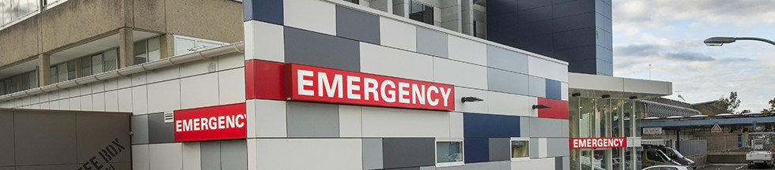

Stakeholders
Western Sydney Local Health District
CEO: Graeme Loy

Slide 4
About Western Sydney Local Health District
WSLHD emergency department recorded 51,702 ED visitors from April to June compared which increased by 10,813 visitors compared to same April to June 2020
All the frontline staff deserve a recognition for tremendous effor

Slide 5
Agenda
Context
Questions
Data Cleaning
Data Visualisation
Summary and Solutions
Data Description

Slide 6
Questions
Data Questions
What are the biggest number of diagnostic that occured in the Hospital ED?
What are the most common departure status in the ED?
Which diagnostic took longest average time of arrival and departure?
Which diagnostic took longest average time of treatment and departure?
Business Questions: How to educate patient to prevent ED Visit

Slide 7
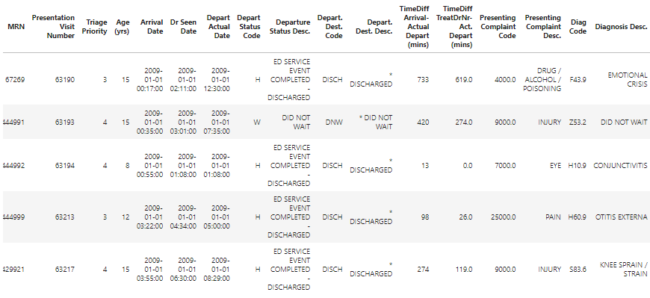
Data Description
Data Size (After Cleaning):
14553 Observations
17 Features

Slide 8
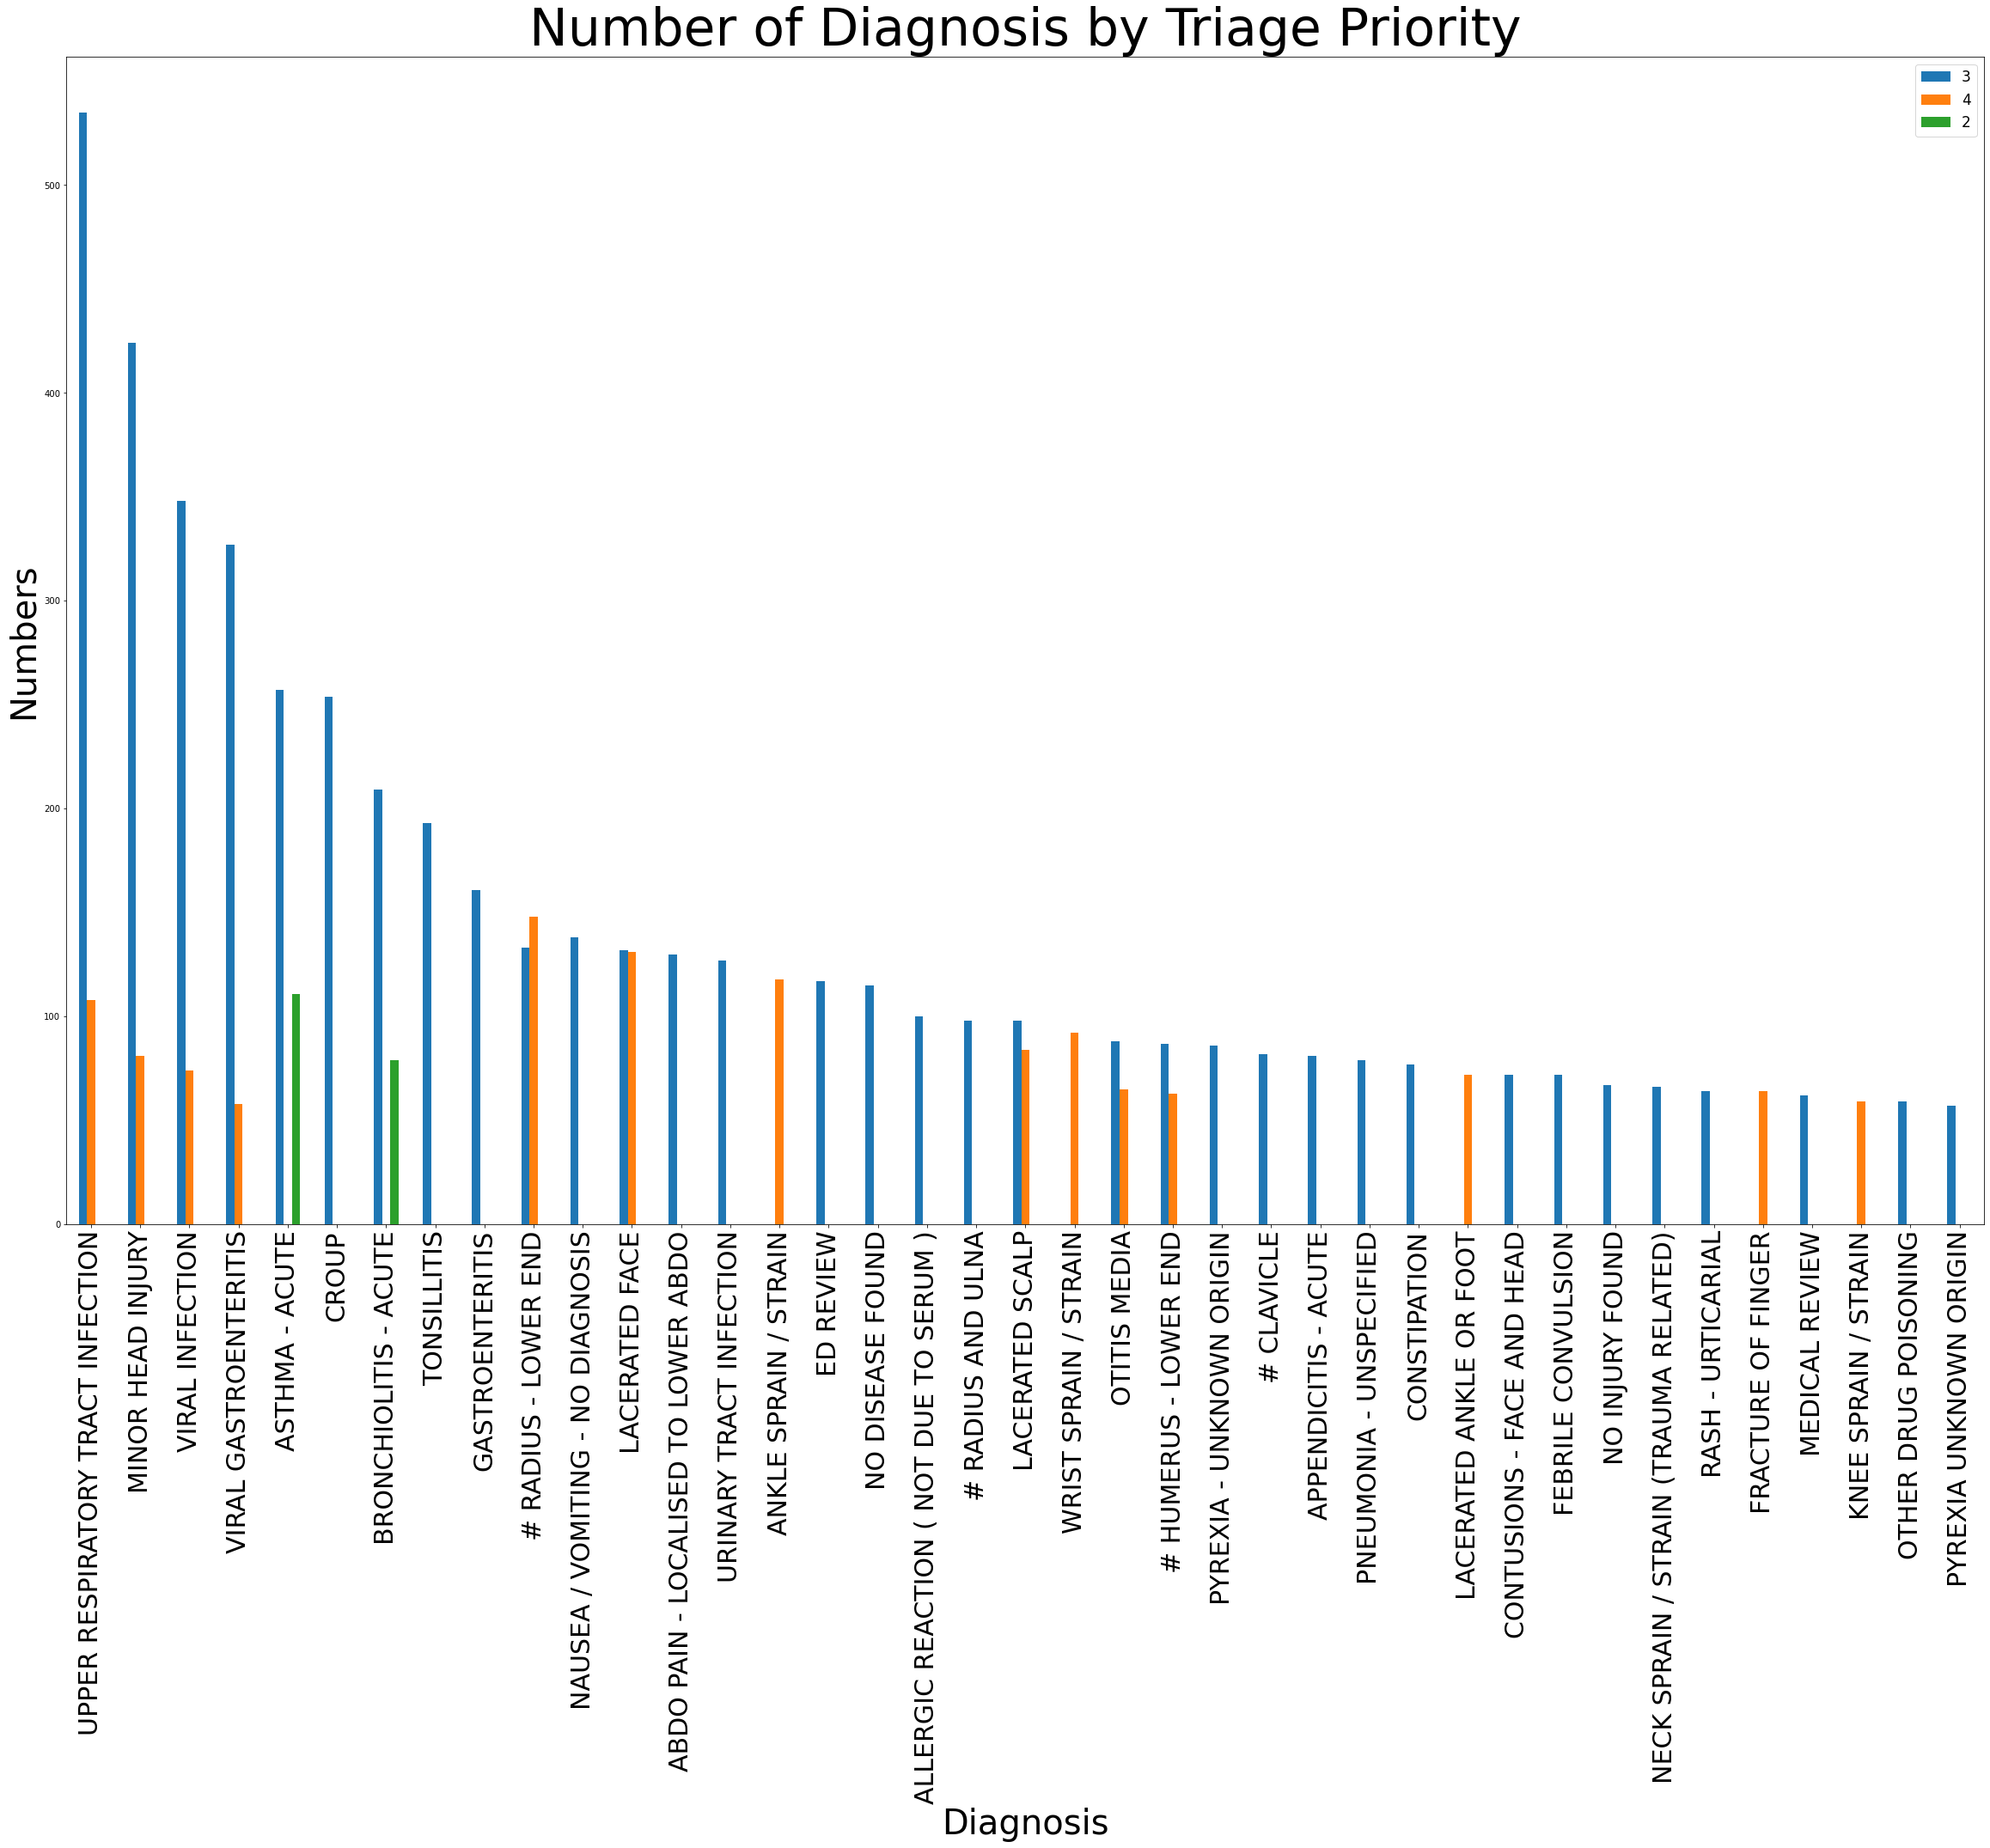
Data Visualisation
Insights: Insight: Majority of the patient that came / was admitted to the ED were diagnosed with upper respiratory tract infection with the triage priority number 3 outnumbered the number 4

Slide 9
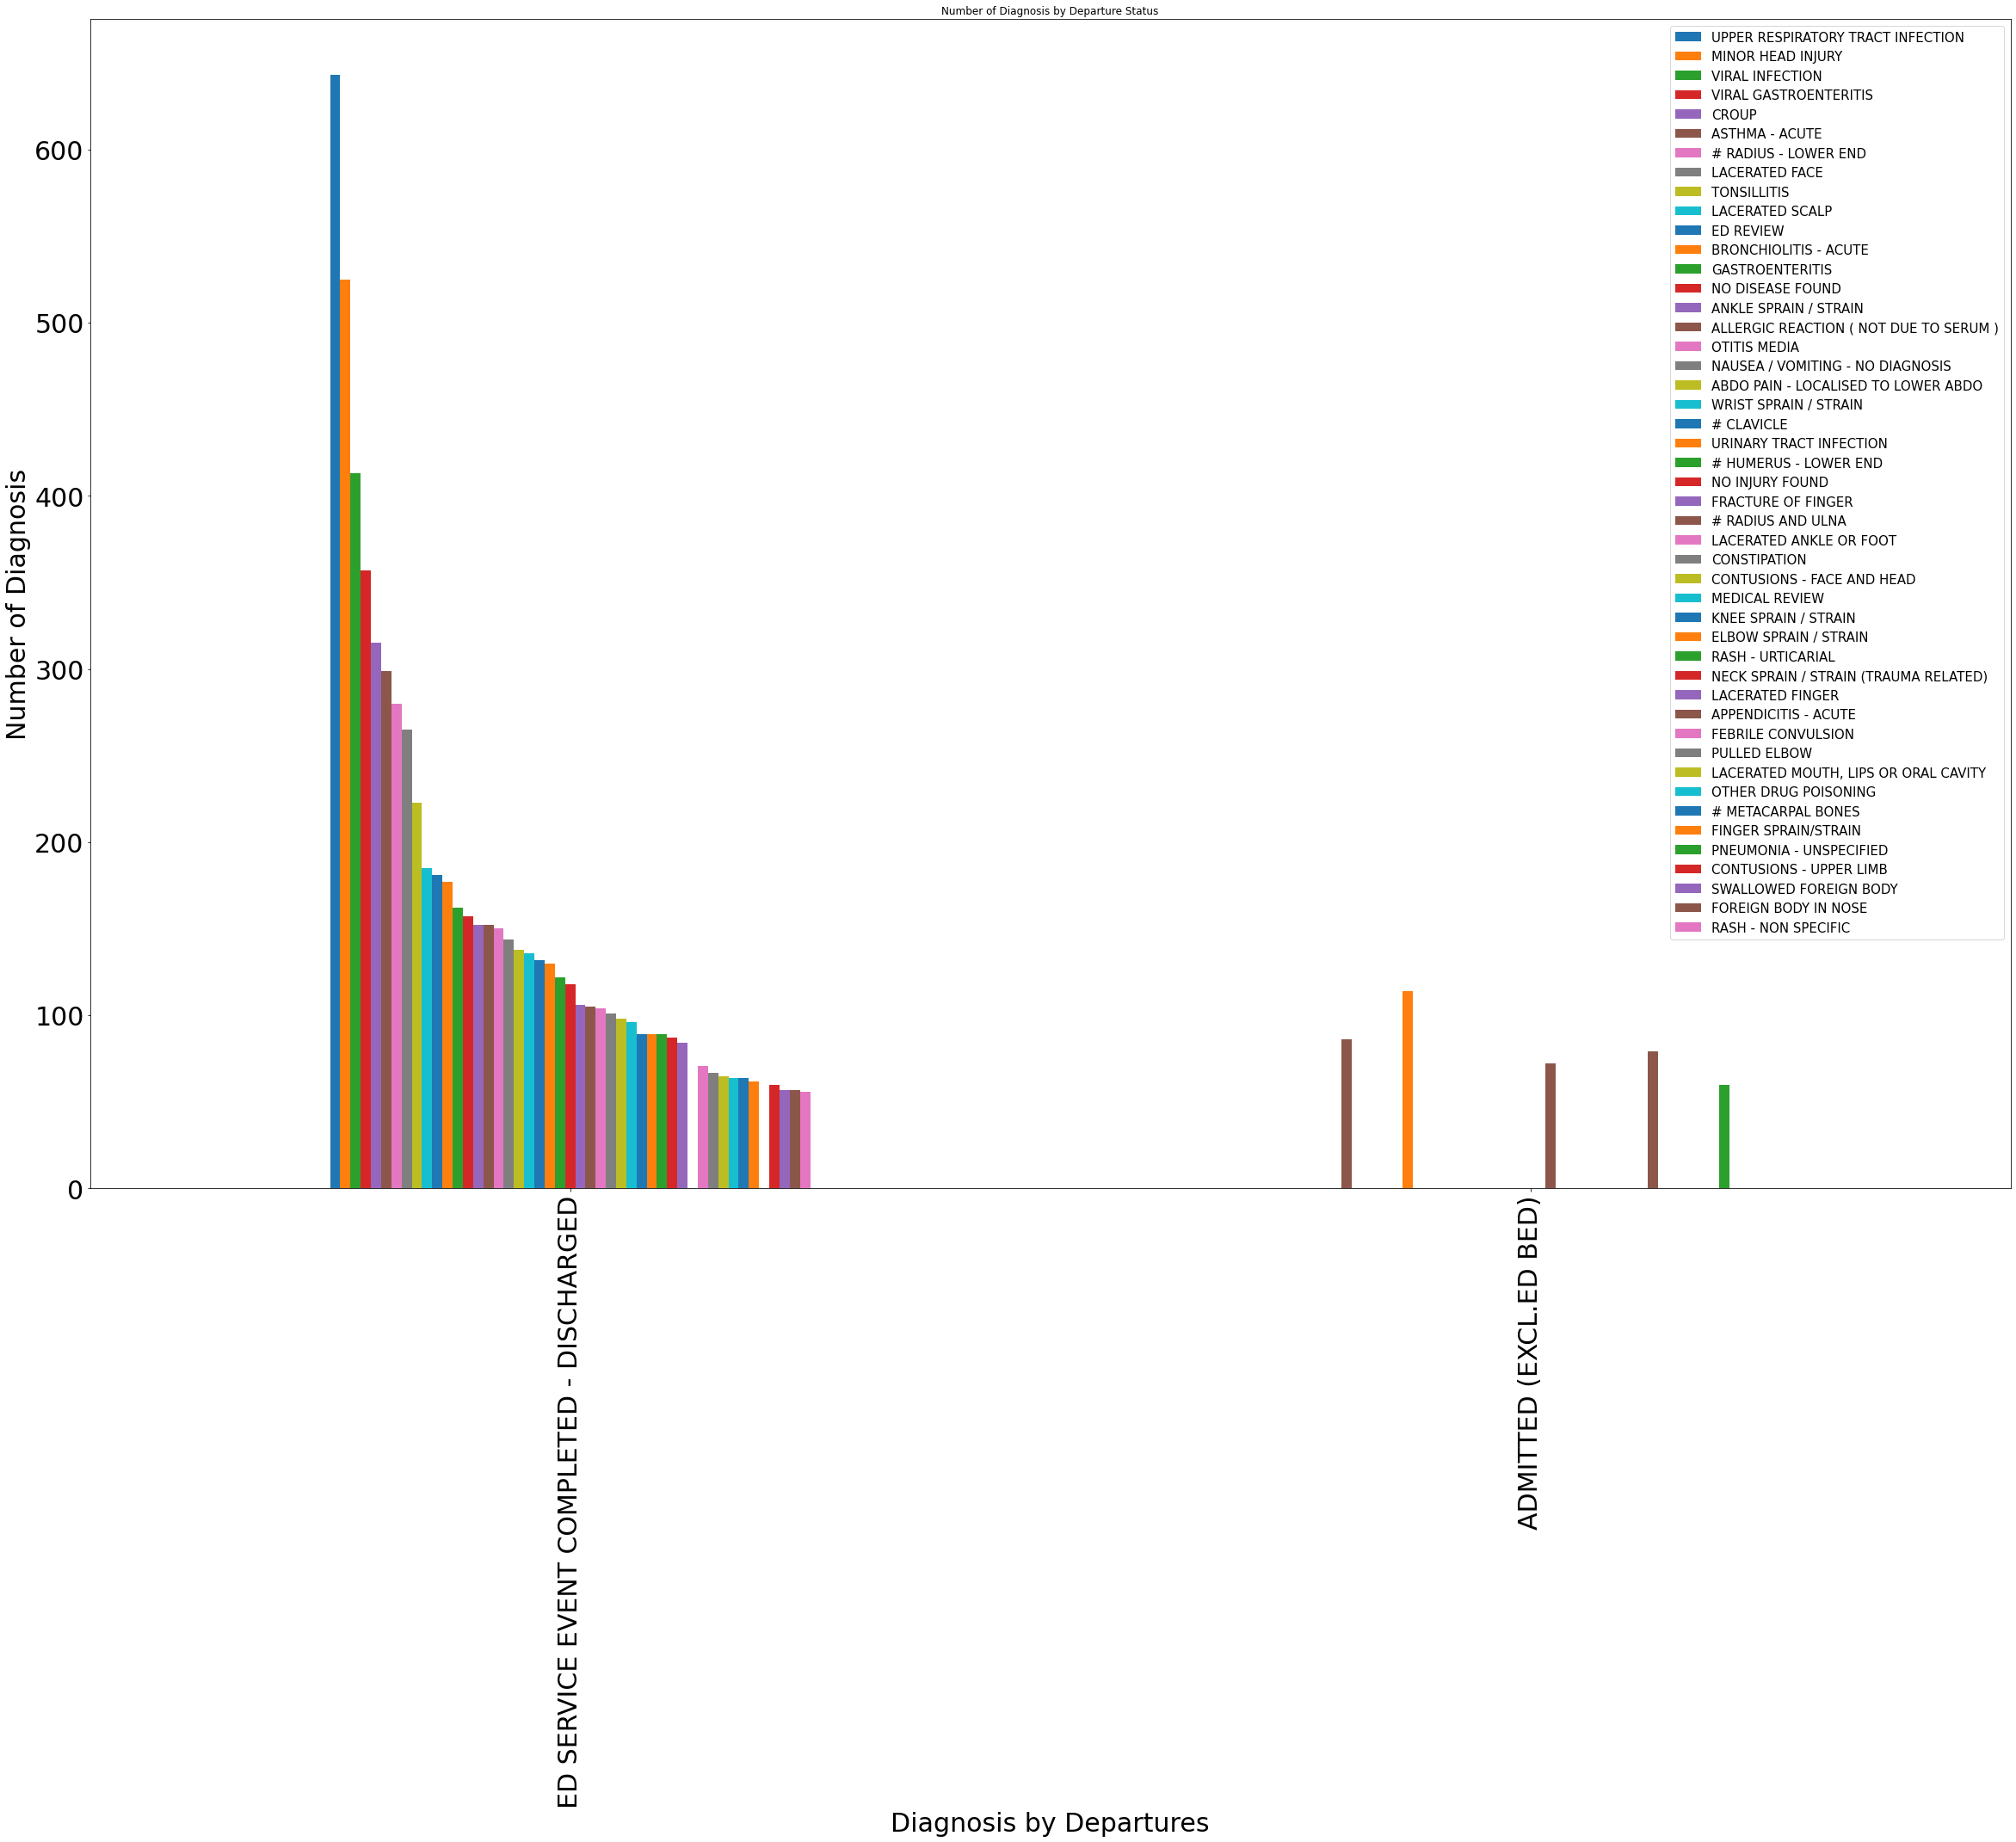
Data Visualisation (Part 2)
Insights: The most common departure in the ED is the status discharged status with the diagnosis such as minor head injury, upper respiratory tract infection, viral infection, viral gastroenteritis etc.

Slide 10
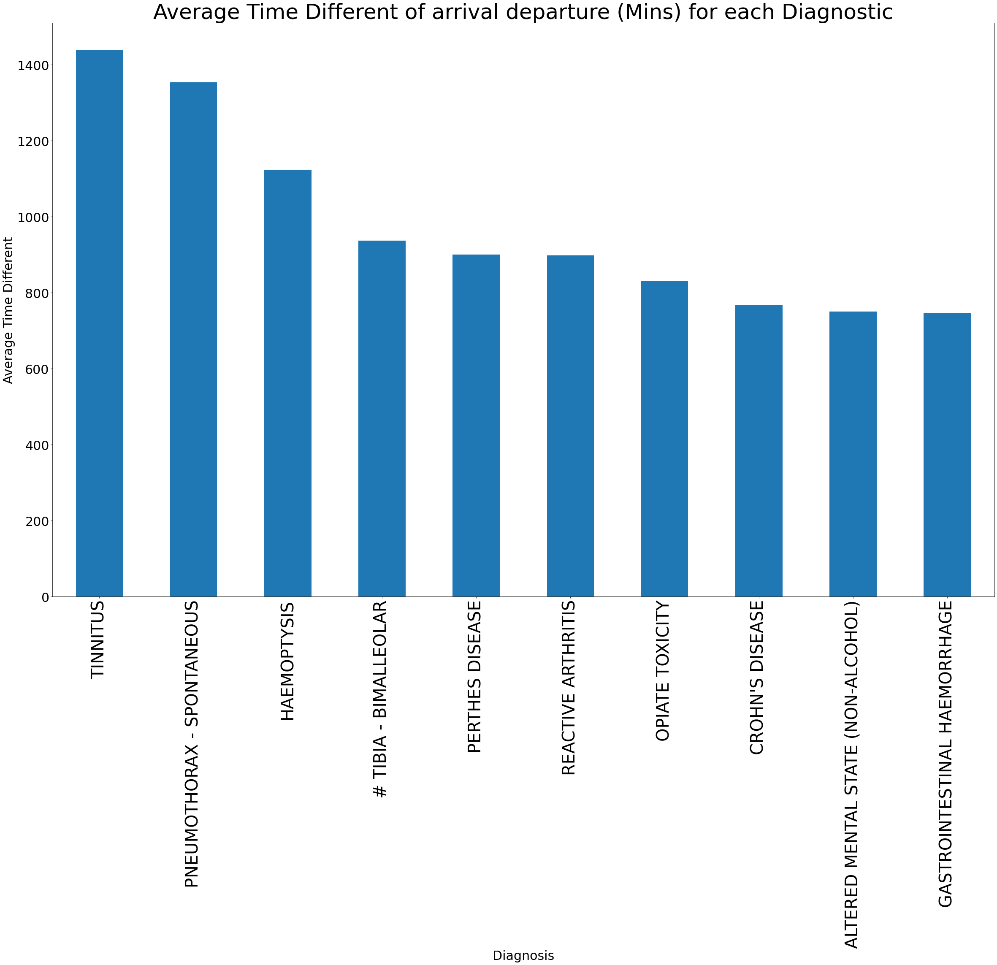
Data Visualisation (Part 3)
Insights: Tinnitus has the longest average time between arrival and departure time.

Slide 11
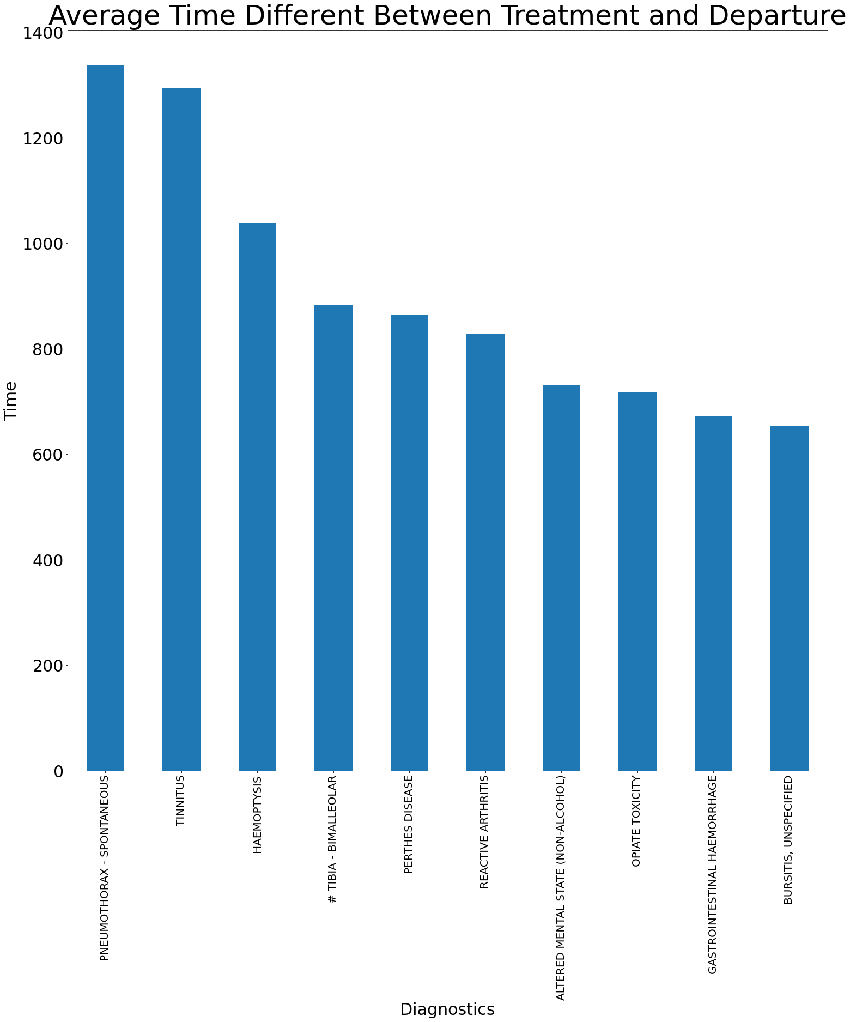
Data Visualisation (Part 4)
Insights: Pneumothorax has the longest average time between treatment departure.

Slide 12
Summary
Insights:
Majority of the patient that came / was admitted to the ED were diagnosed with upper respiratory tract infection.
Tinnitus has the longest average time between arrival and departure time.
Pneumothorax has the longest average time between treatment and departure.
The most common departure in the ED is the status discharged status with the diagnosis such as minor head injury, upper respitory tract infection, viral infection, viral gastroentretis etc.

Slide 13
Solutions
How to reduce unnecessary ED Visits:
Create a campaign to patient such as calling the MD before heading to the ED
Develops a hands to patients where written instructions said Call Your Doctor's Office, Go to Urgent Care and Go to the ER
Provide condition specific follow up guidance to patients
Promote the use of personal health triage applications.
Offer telehealth as an alternative to the ED

Slide 14
Thank You
Any Questions?

